Slide 1
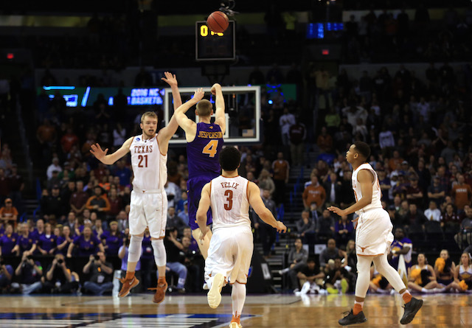
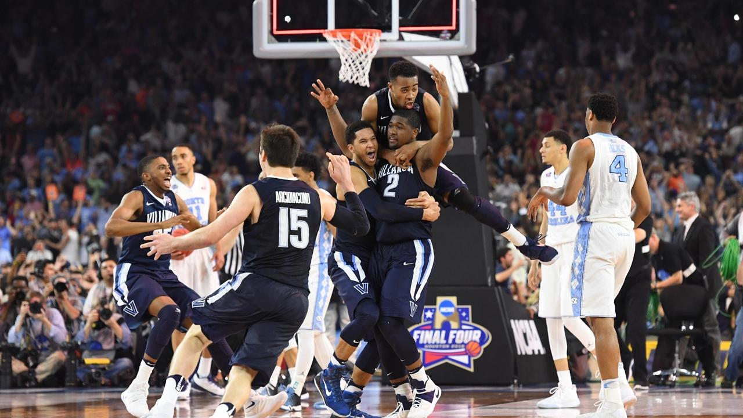

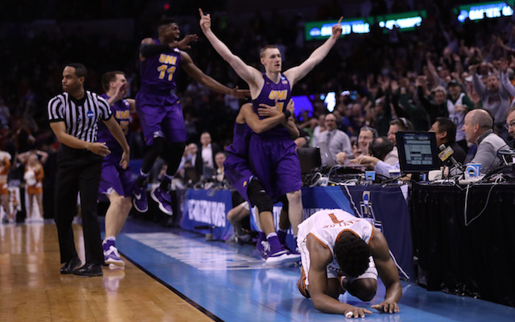
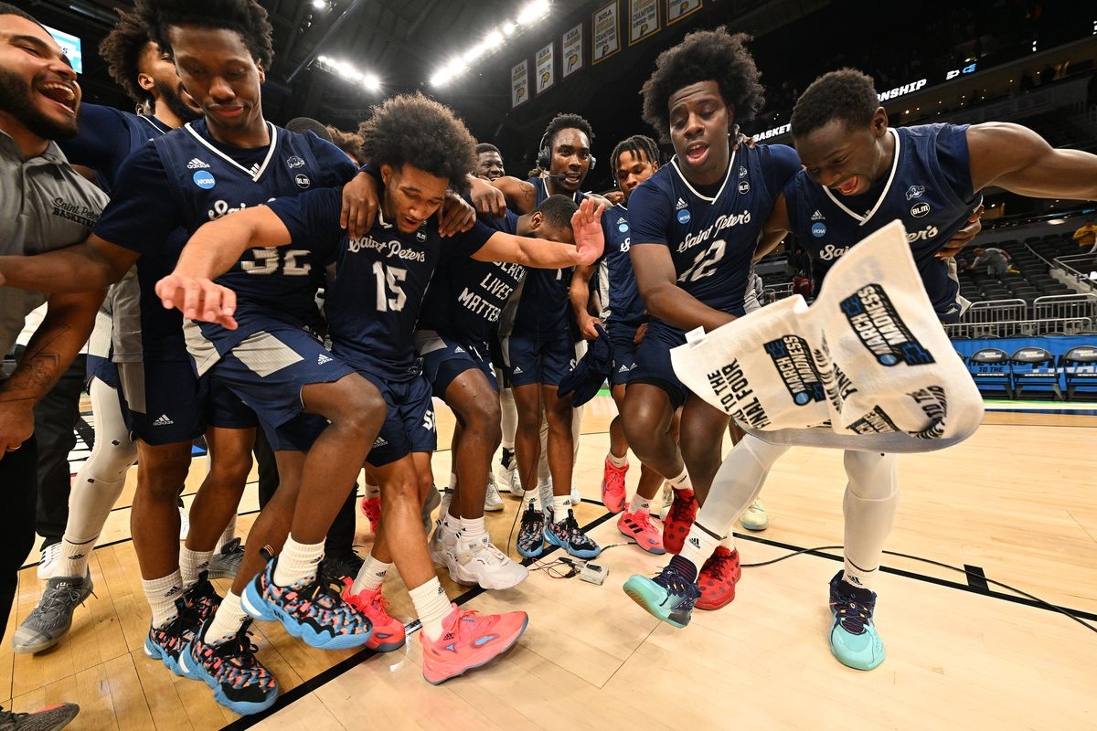
March Madness 2025 Predictions
Daniel Aybar

Slide 2
Overview
Data compiled from March Madness tournament games from 2016-2024 was implemented to predict outcomes for the Men’s 2025 tournament
Several Different predictive methods such as KNN, RIPPER, Naive Bayes, SVM, ANN, and Decision Trees were applied.
Two Predictive methods were used:
For individual teams, total number of wins
For matchups, most likely winner and loser.

Slide 3
Data and Sources
Data was compiled from Kenpom and Basketball Reference
 | Team Dataset | Matchup Dataset
Observations | 516 | 508
Target Variable | Number of Wins (Discrete with range 0:6) | Matchup Winner (Binary 0 or 1)
Descriptive Variables | Individual Team Statistics from regular season (87 initial variables) | Difference in statistics between Team 1 and Team 2 (13 initial variables)

Slide 4
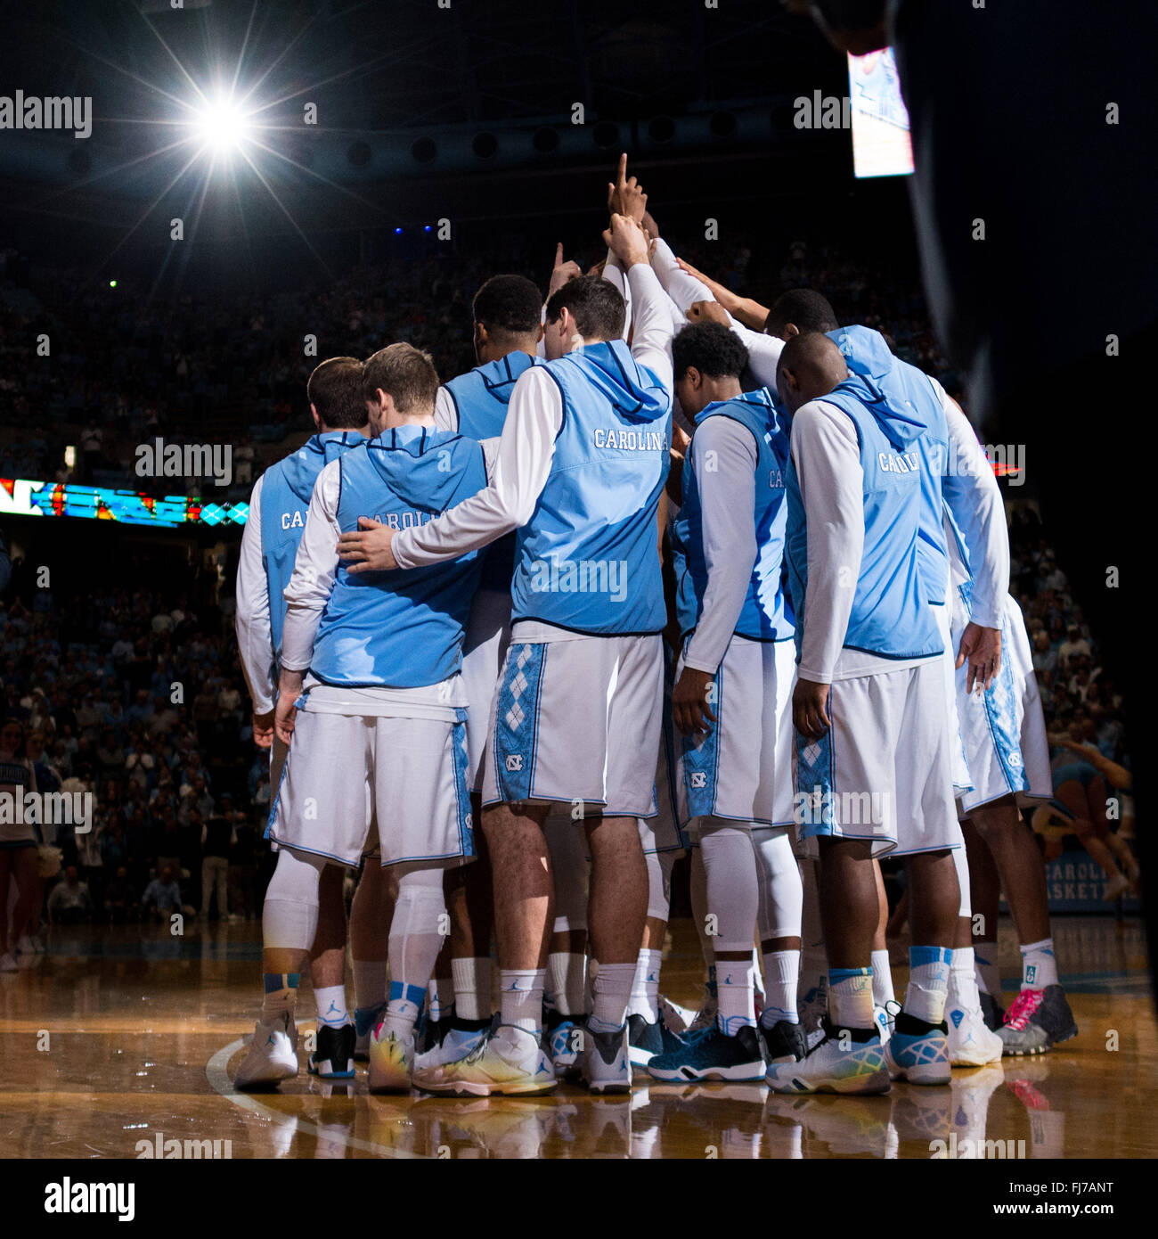
Team Dataset Analysis

Slide 5
Data Description
Variable Name | Variable Description | Min | Med | Max | Mean | SD
TW | Total Wins
THREEper | 3 Point Percentage
O3per | Opponent 3 Point Percentage
PM | Possession Margin
AdjEM | Adjusted Efficiency Margin
AdjD | Adjusted Deffensive Efficiency
AdjO | Adjusted Offensive Efficiency
AdjT | Adjusted Tempo
Luck | Luck
AdjSOS | Adjusted Strength of Schedule

Slide 6
Data Description Continued
Variable Name | Variable Description | Min | Med | Max | Mean | SD
THREEpar | 3 Point Attempt Rate
STLper | Steal Percentage
BLKper | Block Percentage
fta_marg | Free Throw Attempt Margin
pt_marg | Average Point Margin
atr | Assist-to-Turnover Ratio
oatr | Opponent Assist-to-Turnover Ratio
Seed | Tournament Seeding
SRS | Strength of Record
ts_marg | True Shooting Margin

Slide 7
Data Description Continued
Stats with ‘opponent’ in the description take the stats allowed by a given team to their opponents throughout the year.
Example: Team A allowed their opponents to shoot 35% from 3-point shots on average throughout the season. Thus their O3per = 0.35
Stats with ‘margin’ in the description take the given team’s average subtracted by their opponent average.
Example: Team A scored 70 points per game and allowed 66 points per game. Their pt_marg = 4

Slide 8
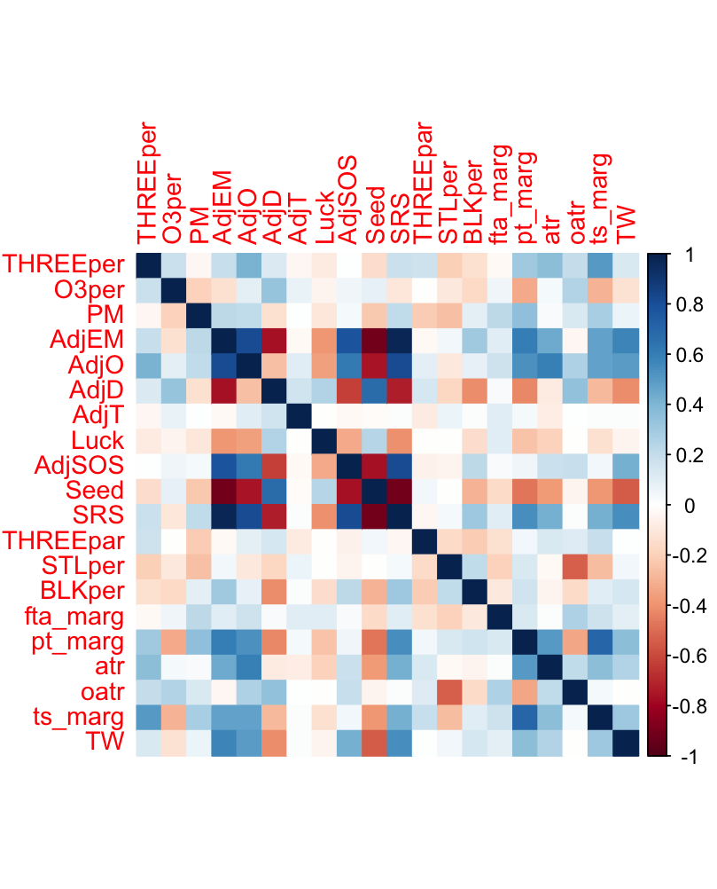
Correlation Plot

Slide 9
Correlation Plot
Several Highly Correlated Descriptive Variables

Slide 10
Correlation Plot
Several Highly Correlated Descriptive Variables
A few variables highly correlated to the target

Slide 11
Feature Selection
Highest correlation to target was AdjEM
Dropped AdjO, Seed, and SRS from the dataset due to high correlation with other descriptive variables
Kept several low correlation variables as well as AdjD and AdjSOS to avoid too much information loss.
All data was standardized to have mean = 0 and sd = 1.

Slide 12
Target Variable Manipulation
Because the data has a large class imbalance, Several new binary target variables were created.
Round2: TW > 0
Sweet16: TW > 1
Elite8: TW > 2
Round2 | n | Proportion
0 | 261 | 50.6%
1 | 255 | 49.4%
TW | n | Propotion
0 | 261 | 50.6%
1 | 130 | 25.2%
2 | 61 | 11.8%
3 | 32 | 6.2%
4 | 16 | 3.1%
5 | 8 | 1.55%
6 | 8 | 1.55%
Sweet 16 | n | Proportion
0 | 391 | 75.8
1 | 125 | 24.2%
Elite8 | n | Proportion
0 | 452 | 87.6%
1 | 64 | 12.4%

Slide 13
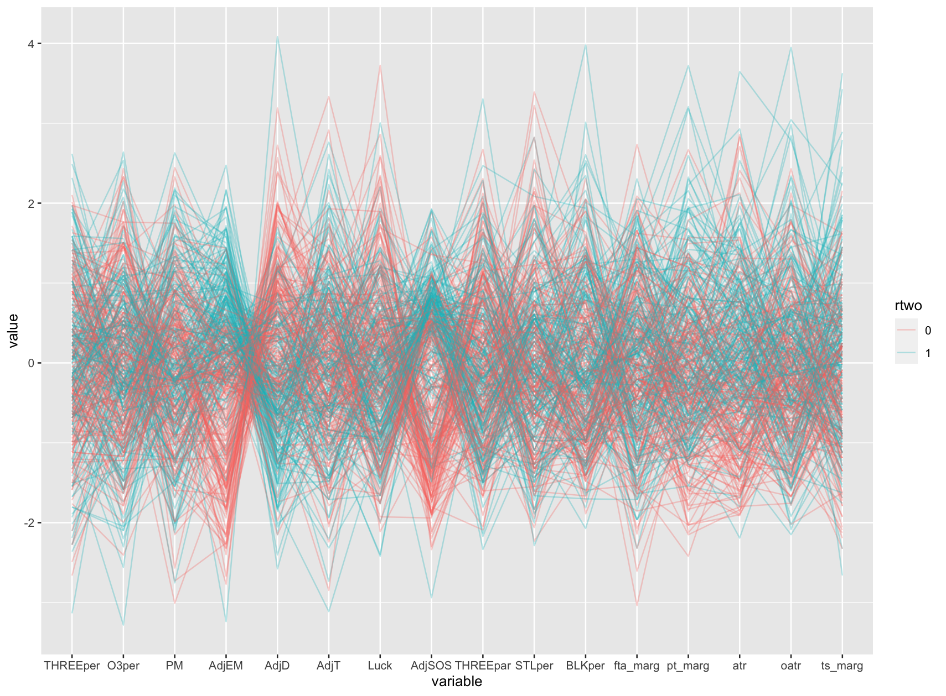
Coordinates Plot
Blue Strings = Teams that won in the first round
Red Strings = Teams that lost in the first round.

Slide 14
Coordinates Plot
High correlation between certain descriptive variables and the target (rtwo) can be seen in the chart

Slide 15
Coordinates Plot
High correlation between certain descriptive variables and the target (rtwo) can be seen in the chart
Blue clusters show attributes that reflect well on winning Round 1 games

Slide 16
Coordinates Plot
High correlation between certain descriptive variables and the target (rtwo) can be seen in the chart
Blue clusters show attributes that reflect well on winning Round 1 games
Red clusters show attributes that are correlated with losing Round 1 games

Slide 17
Coordinates Plot
High correlation between certain descriptive variables and the target (rtwo) can be seen in the chart
Blue clusters show attributes that reflect well on winning Round 1 games
Red clusters show attributes that are correlated with losing Round 1 games
Mixed clusters show low correlation to the target

Slide 18
Coordinates Plot
The same variables that were highly correlated to TW seem to be strong predictors of rtwo:
Strong positive relationship with AdjEM and AdjSOS
Strong negative relationship with AdjD

Slide 19
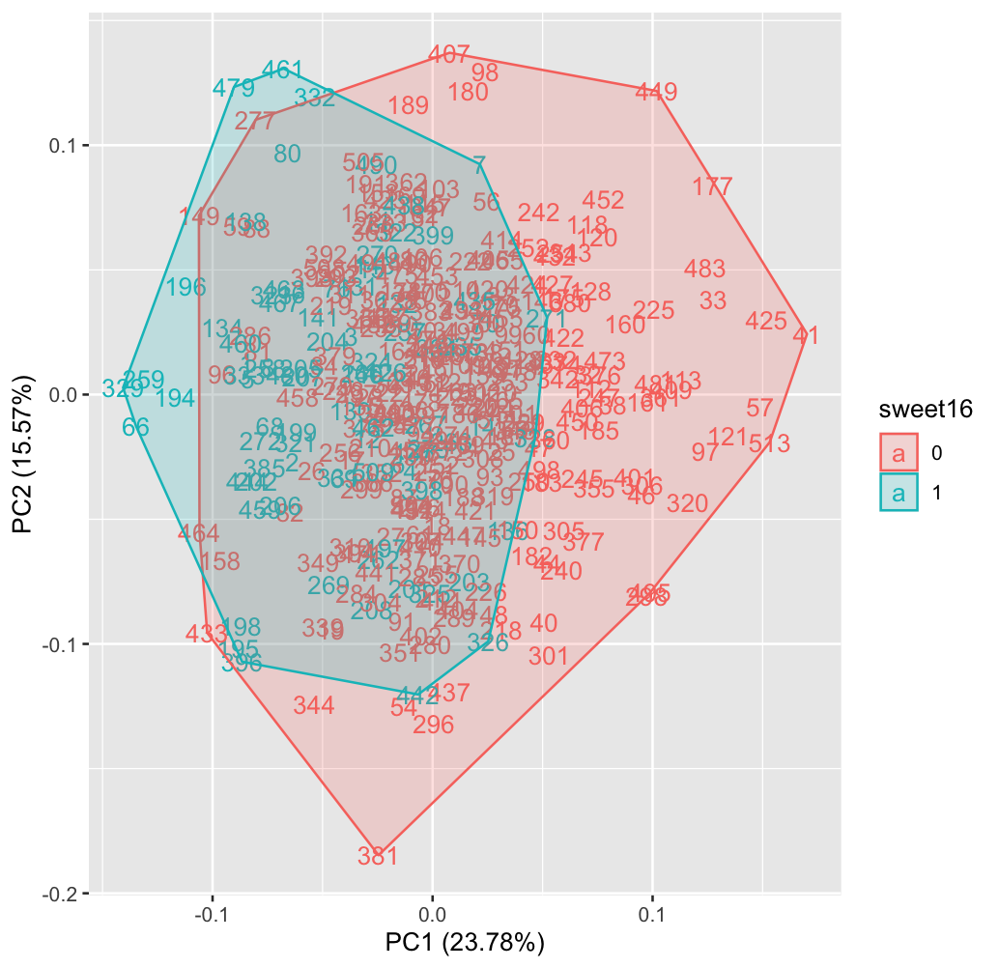
PCA Plot
Tries to encapsulate all the descriptive variables in a 2-dimensional space.
Descriptive variable = sweet16

Slide 20
PCA Plot
Tries to encapsulate all the descriptive variables in a 2-dimensional space.
Descriptive variable = sweet16
Large blue regions mean it is easy to identify Sweet 16 teams

Slide 21
PCA Plot
Tries to encapsulate all the descriptive variables in a 2-dimensional space.
Descriptive variable = sweet16
Large blue regions mean it is easy to identify Sweet 16 teams
Large red regions mean it is easy to identify non-Sweet 16 teams

Slide 22
PCA Plot
Tries to encapsulate all the descriptive variables in a 2-dimensional space.
Descriptive variable = sweet16
Large blue regions mean it is easy to identify Sweet 16 teams
Large red regions mean it is easy to identify non-Sweet 16 teams
Large mixed regions mean there is a lot of uncertainty in predictions.

Slide 23
PCA Plot
Because there is a small blue region and a larger red region, it can be inferred that it is easier to identify bad teams (losers) than good teams (sweet16 or farther).
The larger overlapping area suggests there is a lot of uncertainty in predicting sweet16 teams.

Slide 24
Best Predictors
Model Name | Target Variable | Accuracy
KNN 11 | Round2 | 77.3%
KNN 3 | Elite8 | 94.2%
Ripper | Sweet16 | 83%
Naive Bayes | TW | 48.05%

Slide 25
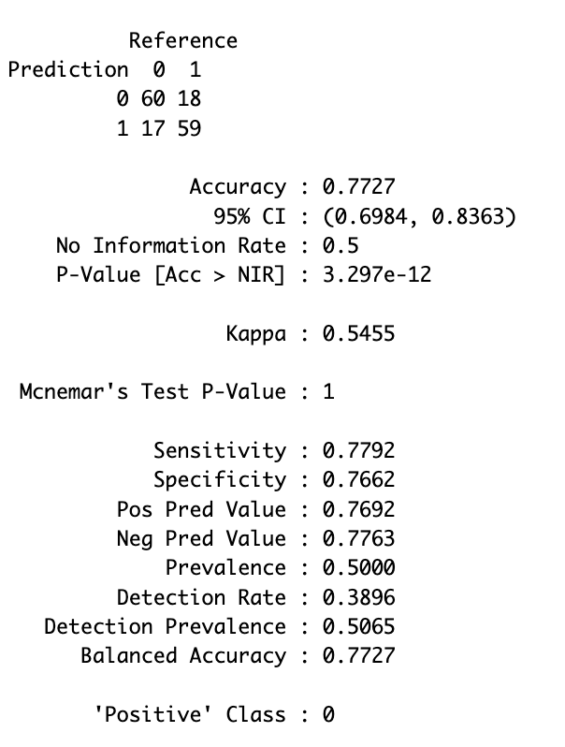
KNN-11 Round2
Strengths:
Good class balance, balanced accuracy
Much better than random guess
Weaknesses:
Not exceptional

Slide 26
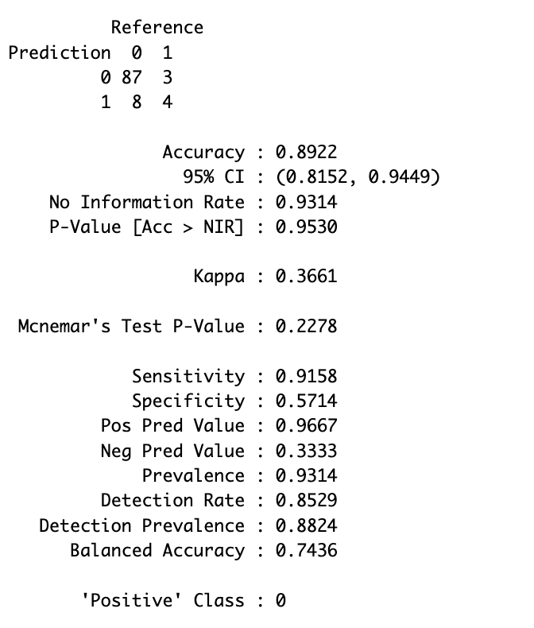
KNN-3 Elite8
Strengths:
Excellent accuracy and balanced accuracy
Weaknesses:
Slight class imbalance issue
Despite high accuracy, correctly identifies only 57% of Elite 8 teams

Slide 27
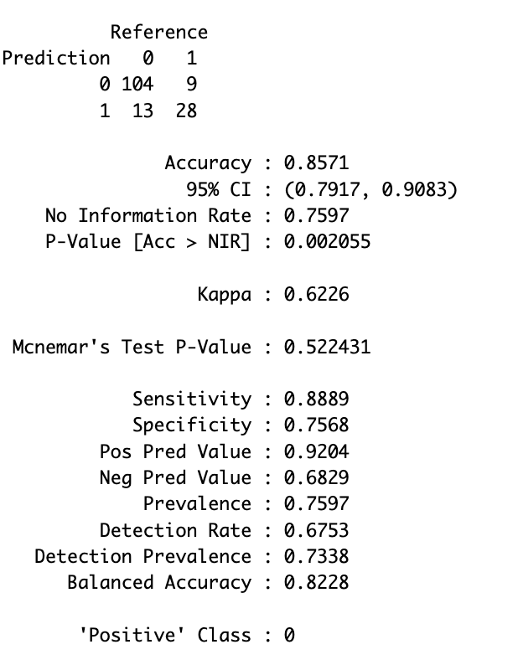
Ripper Sweet16
Strengths:
Excellent accuracy
Very good balanced accuracy
Good class balance
Correctly identifies 75% of sweet 16 teams
Weaknesses:
No specific weakness

Slide 28
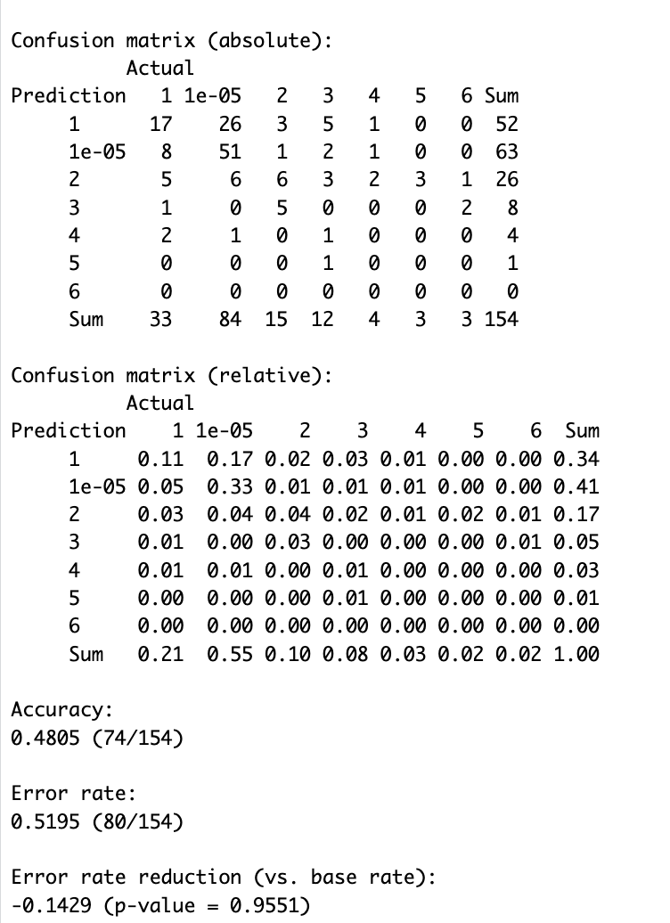
Naive Bayes TW
Strengths:
Most mistakes are local (off by 1 game)
Best TW model
Weaknesses:
Terrible overall accuracy
No teams with 4+ wins are even close to correctly identified.
Class imbalance
No error reduction

Slide 29
Predictions: Top Teams
Team Name | Seed | KNN32 | Ripper16 | KNN8 | Naive Bayes TW | Total Score*
Florida | 1 | 1 | 1 | 1 | 6 | 2
Duke | 1 | 1 | 1 | 1 | 6 | 2
Houston | 1 | 1 | 1 | 0 | 5 | 1.333
Alabama | 2 | 1 | 1 | 0 | 4 | 1.167
*Total Score = 1/6*KNN32 + 1/3*Ripper16 + 1/2*KNN8 + 1/6*NBTW
Florida and Duke are the biggest favorites based on the results of these models.
Houston and Alabama are other teams that could contend.

Slide 30
Predictions: Sleepers
Team Name | Seed | KNN32 | Ripper16 | KNN8 | Naive Bayes TW | Total Score*
Illinois | 6 | 1 | 0 | 1 | 2 | 1
Arizona | 4 | 1 | 1 | 0 | 3 | 1
Gonzaga | 8 | 1 | 1 | 0 | 2 | 0.833
BYU | 6 | 1 | 0 | 1 | 1 | 0.833
VCU | 11 | 1 | 0 | 0 | 1 | 0.333
*Total Score = 1/6*KNN32 + 1/3*Ripper16 + 1/2*KNN8 + 1/6*NBTW
Illinois and Arizona are tied for the 5th highest scores suggesting they could make a deep run
Gonzaga and BYU are lower seeds that could make deeper runs
VCU has the highest score among double-digit seeds

Slide 31
Predictions: Most Likely to be Upset
Team Name | Seed | KNN32 | Ripper16 | KNN8 | Naive Bayes TW | Total Score*
Memphis | 5 | 0 | 0 | 0 | 0 | 0
Texas A&M | 4 | 0 | 0 | 0 | 2 | 0.333
Oregon | 5 | 1 | 0 | 0 | 1 | 0.333
Ole Miss | 6 | 1 | 0 | 0 | 1 | 0.333
Michigan | 5 | 1 | 0 | 0 | 2 | 0.5
Missouri | 6 | 1 | 0 | 0 | 2 | 0.5
Wisconsin | 3 | 0 | 1 | 0 | 2 | 0.667
*Total Score = 1/6*KNN32 + 1/3*Ripper16 + 1/2*KNN8 + 1/6*NBTW
Memphis is the only top 6 seed with a score of 0
Texas A&M, Oregon, Ole Miss, Michigan and Missouri are higher seeds that could lose early
Wisconsin has the lowest score among top 4 seeds.

Slide 32
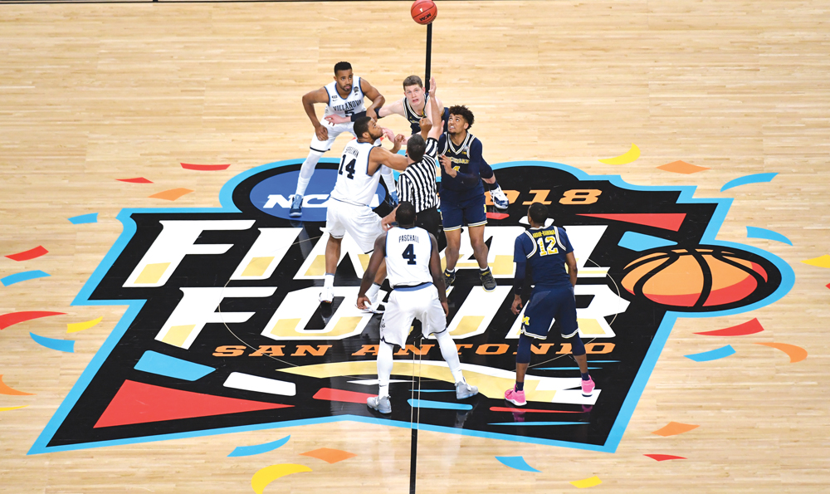
Matchup Dataset Analysis

Slide 33
Data Description
Variable Name | Variable Description | Min | Med | Max | Mean | SD
W | Team 1 win or loss | 0 |  | 1
AdjEMdiff | Adjusted Efficiency Margin Difference
AdjOdiff | Adjusted Offensive Efficiency Difference
AdjDdiff | Adjusted Deffensive Efficiency Difference
SeedDiff | Seed Difference
pmDiff | Possession Margin Difference
AdjSOSdiff | Adjusted Strength of Schedule Difference
TempoDiff | Adjusted Tempo Difference
LuckDIff | Luck Difference
RbpDiff | Rebound Percentage Difference
3parDiff | 3 Point Attempt Rate Difference

Slide 34
Data Description Continued
All variables with “Difference” in their description take the average season statistics of a given team and subtract it by their opponent’s.
Ex: Team 1 had an AdjEM of 30 during the regular season, while their first round opponent Team 2, had an AdjEM of 26.
The AdjEMdiff = 4
The higher seed was placed as Team1 50% of the time to try to even out the class balance of the binary W variable.
If Team 1 wins, W = 1.
If Team 2 wins, W = 0.

Slide 35
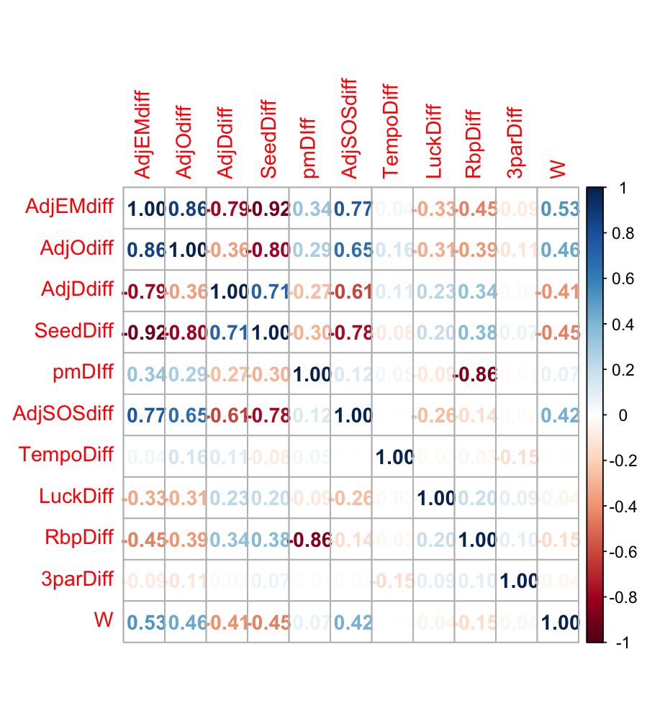
Correlation Plot

Slide 36
Correlation Plot
A few highly correlated descriptive variables again

Slide 37
Correlation Plot
A few highly correlated descriptive variables again
Several variables with negligable correlation to target

Slide 38
Feature Selection
pmDiff, TempoDiff, LuckDiff, and 3parDiff were all dropped due to low correlation to the target variable.
Several highly intercorrelated variables were kept, mainly to try to prevent information loss, as all had high correlation to the target.
All data was once again standardized to have mean = 0 and standard deviation = 1.

Slide 39
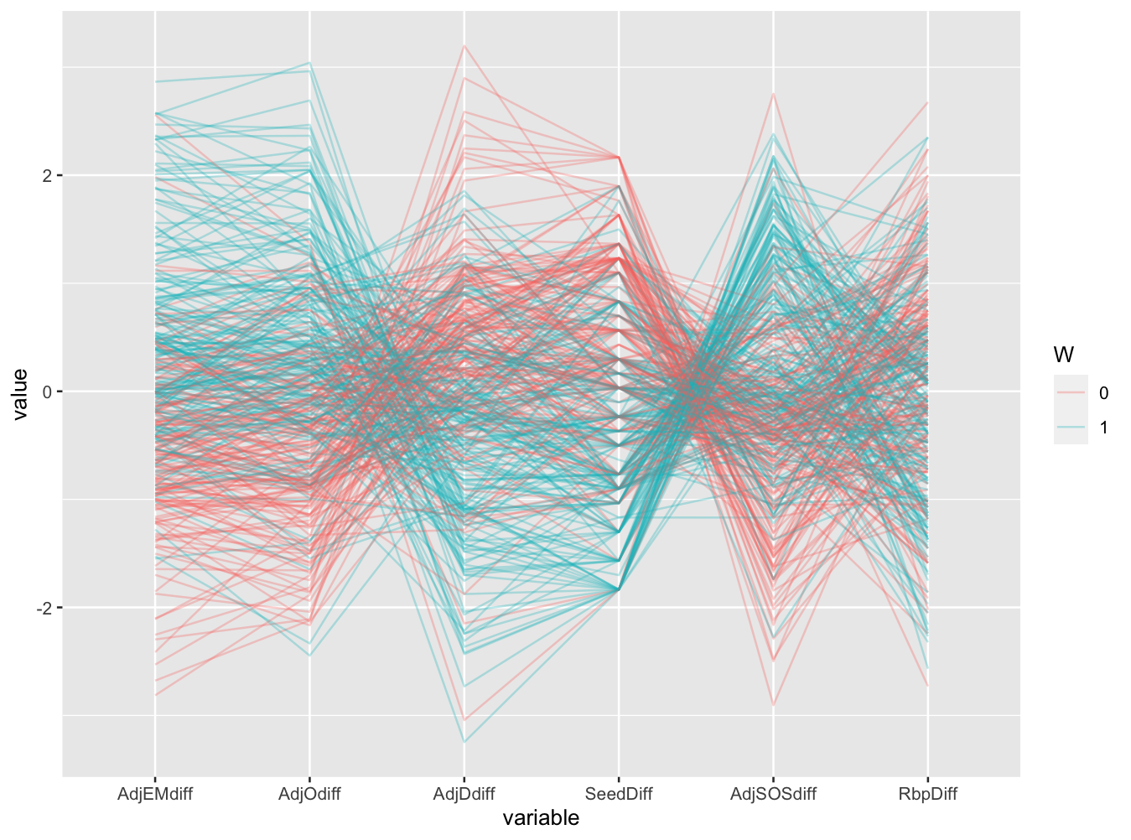
Coordinates Plot
All variables seem to show a strong relation to the target variable

Slide 40
Coordinates Plot
All variables seem to show a strong relation to the target variable
Positive:
AdjEMdiff
AdjOdiff
AdjSOSdiff
Negative:
AdjDdiff
SeedDiff
RbpDiff

Slide 41
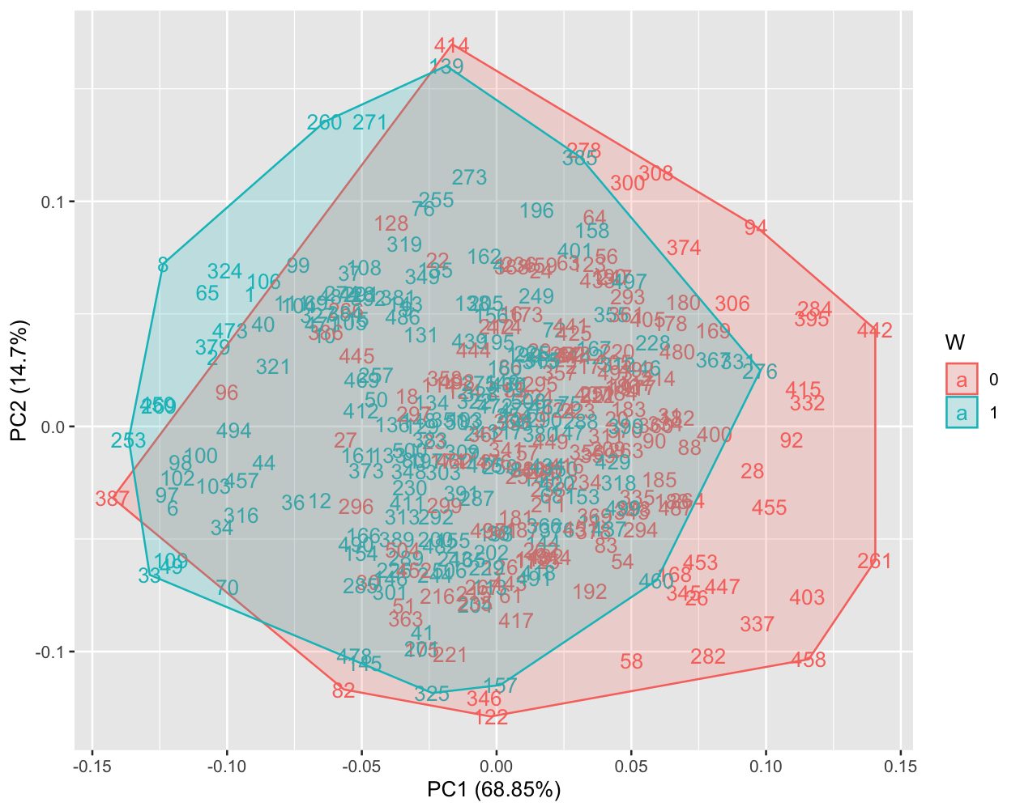
PCA Plot

Slide 42
PCA Plot
Large overlapping space means lots of unpredictability

Slide 43
PCA Plot
Large overlapping space means lots of unpredictability
Independent red and blue space means there are certain easily identifiable matches

Slide 44
PCA Plot
Large overlapping space means lots of unpredictability
Independent red and blue space means there are certain easily identifiable matches
Slightly larger red space is due to chance, as there should be no difference between average ability of Team 1 and Team 2

Slide 45
Best Predictors
Model Name | Accuracy
KNN 3 | 73.7%
Naive Bayes Classifier* | 71.1%
Polynomial SVM* | 77.63%
Radial SVM | 75%
Cost SVM* | 76.32
Simple ANN | 77%
*Naive Bayes, Polynomial SVM, and Radial SVM were all dropped because they essentially only picked higher seeds.*

Slide 46
Predictions: Top Teams
Team Name | Seed | KNN 3 Total Wins | ANN Total Wins | RSVM Total Wins | Total Score*
Florida | 1 | 5 | 6 (champions) | 5 | 16
Houston | 1 | 6 (champions) | 5 | 4 | 15
Duke | 1 | 4 | 4 | 6 (champions) | 14
Auburn | 1 | 4 | 4 | 4 | 12
Each model had all the #1 seeds make the Final 4
Florida, Houston, and Duke were all predicted as champions in at least one model
Florida was the top overall team, but Duke and Houston were very close.

Slide 47
Predictions: Round 1 Potential Upsets
Team 1 | Team 2 | KNN 3 | ANN | SVM C | Total Upset Score
Texas/Xavier (11) | Illinois (6) | 1 | 1 | 1 | 3
Memphis (5) | Colorado St (12) | 1 | 0 | 0 | 2
Vanderbilt (10) | St. Mary’s (7) | 0 | 1 | 1 | 2
Michigan (5) | UC San Diego (12) | 1 | 0 | 1 | 1
VCU (11) | BYU (6) | 0 | 1 | 0 | 1
The most likely upset based on these 3 models is Illinois losing to the winner of the play-in game between Texas and Xavier, with all 3 models choosing the lower seed.
2 models selected the lower seed in Memphis vs Colorado St. as well as Vanderbilt vs St. Mary’s
Only the ANN model selected upsets in Michigan vs UC San Diego and VCU vs BYU, but they are still ones to keep an eye on

Slide 48
Predictions: Further Potential Upsets
Team 1 | Team 2 | KNN 3 | ANN | SVM C | Total Upset Score
Kansas (7) | St. John’s (2) | 1 | 1 | 1 | 3
Texas A&M (4) | UC San Diego (12) | 1 | 0 | 1 | 1
Wisconsin (3) | BYU (6) | 0 | 1 | 1 | 1
Ole Miss (6) / Iowa St. (3) | Michigan St. (2) | 0 | 1 | 1 | 2
7-seed Kansas upsetting St. John’s in the second round was the most popular upset, and was predicted by all 3 models.
UC San Diego beating Texas A&M and Wisconsin losing to BYU were both predicted by 1 model.
The ANN model chose Ole Miss to beat Iowa St. in the second round and Michigan St. in the Sweet 16, while the Cost SVM model predicted Iowa St. to survive and go on to beat Michigan St.

